Slide 1
Week 7 Demo
Krausz András
Github handle:
judashgriff

Slide 2
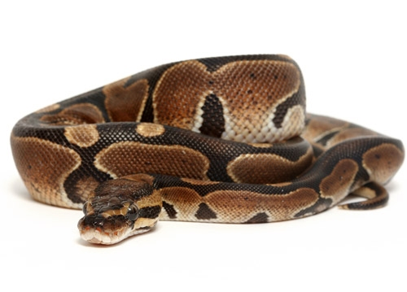

Python vs JavaScript

